Slide 1
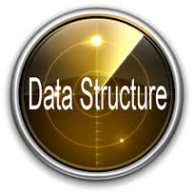
Unit 1
Concept and Definition of Data Structures

Slide 2
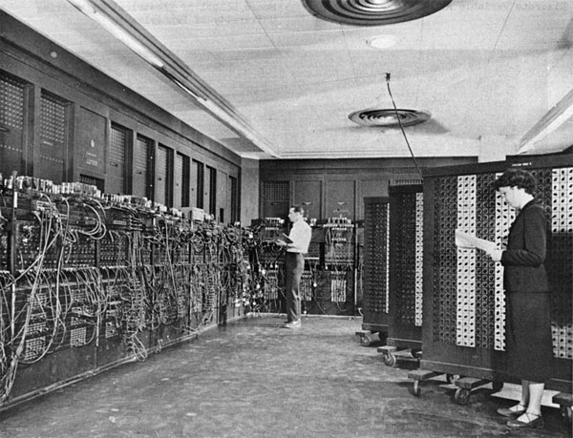



Computers

Slide 3
How has Computer changed?
Storage: What do Computer Store?
Speed: What do Computer process?
At the end of the day, Its all about DATA

Slide 4
Goal
As computers become faster and faster, the need for programs that can handle large amounts of input becomes more acute.
This requires more careful attention to efficiency, since inefficiencies in programs become most obvious when input sizes are large.
By analyzing an algorithm before it is actually coded, we can decide if a particular solution will be feasible.
The goal is to develop good programming and algorithm analysis skills simultaneously so that we can develop such programs with the maximum amount of efficiency.

Slide 5
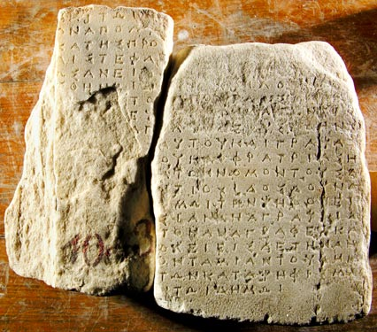


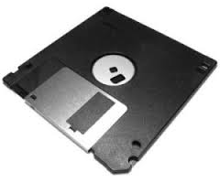

Data – Storage, processing & retrieval

Slide 6
Some Facts about Data
More data has been created in the past two years than in the entire previous history of the human race.
According to computer giant IBM, 2.5 Exabyte - that's 2.5 billion gigabytes (GB) - of data was generated every day in 2012.
Google now processes over 40,000 search queries every second on average , which translates to over 3.5 billion searches per day and 1.2 trillion searches per year worldwide.
Facebook users send on average 31.25 million messages and view 2.77 million videos every minute.

Slide 7
Knowing the basics
Data: Facts and statistics collected together for reference or analysis
Data type: A data type or simply type is a classification of data which tells the compiler or interpreter how the programmer intends to use the data.
Data structure: A particular way to store and organize data in a computer so that it can be used efficiently.

Slide 8
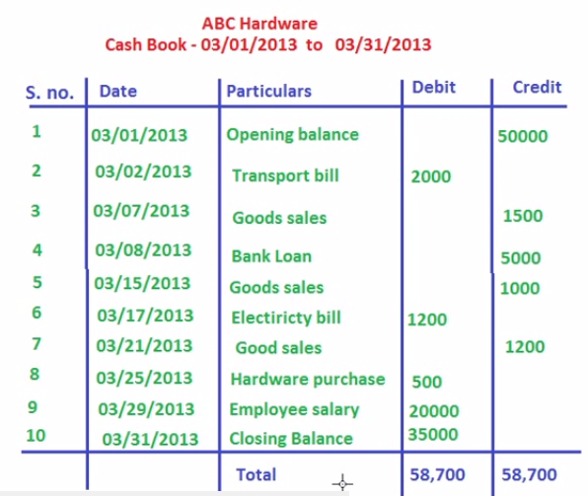
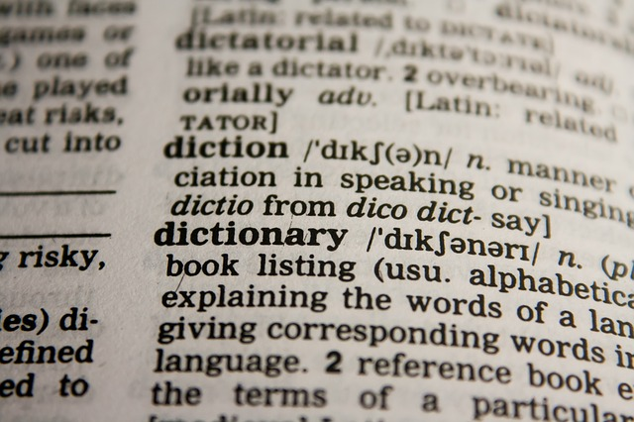
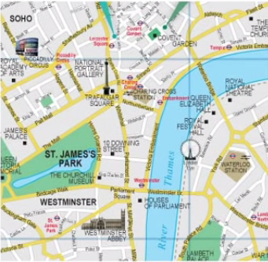
Data Structures
Dictionary
Map
Accounting
Different Kinds of Structure are needed to organize different kinds of data

Slide 9
Need of a Data Structure
A data structure helps you to understand the relationship of one data element with the other and organize it within the memory.
Consider an example, list of names of months in a year.
Similarly consider a set of data that represents location of historical places in a country.
  Such data form a hierarchical relationship between them and must be represented in the memory using a hierarchical type of data structure

Slide 10
Nepal
Kathmandu
Bhaktapur
Lalitpur
Mahabauddha
temple
pashupati
suryabinayak
Krishna mandir
baglamukhi
Fig. hierarchical representation

Slide 11
Basic concepts in Data Structure
Data Structure is a way of collecting and organizing data in such a way that we can perform operations on these data in an effective way.
For example, we have data of player's name “Shakti" and age 32. Here “Shakti" is of String data type and 32 is of integer data type.

Slide 12
Theory: DATA STRUCTURE
It’s a branch of computer science that unleashes the knowledge of
  How data should organized
  How the flow of data should be controlled and
  How data structure should be designed and implemented to reduce the complexity and increase the efficiency of the algorithm.
It enables you to design and implement various data structure, for example, the stacks, queues, linked lists, trees and graphs.
Effective use of principles of data structures increases efficiency of algorithms to solve problems like searching, sorting, populating and handling huge set of data.

Slide 13
Objective of Data Structure
To identify and create useful mathematical entities to determine what classes of problems can be solved by using these entities and operations.
To determine the representations of these abstract entities and to implement the abstract operations on these concrete representations.

Slide 14
Data structures are widely applied in areas like
Compiler design
Operating system
Statistical analysis package
DBMS
Numerical analysis
Simulation
Artificial Intelligence
Graphics

Slide 15
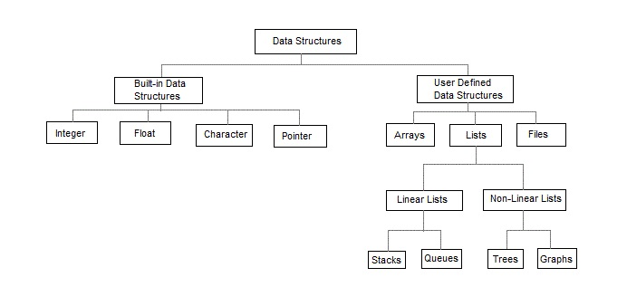

Slide 16
Information
Till now, we have been using the word ‘Data’ for our understanding.
Now, Consider Thinking and finding what meaning does ‘Information’ hold?

Slide 17
Algorithm
A process or set of rules to be followed in calculations or other problem-solving operations, especially by a computer.
A self-contained sequence of actions to be performed.
Data Structure and Algorithm are everywhere

Slide 18
Two Simple Rules for Algorithm
Algorithm must solve the problem.
Must solve the problem efficiently

Slide 19
What does Efficiency mean for us?
An Algorithm is said to be efficient, if it Takes less time to execute and Consumes less memory space.
The performance of an algorithm is measured on the basis of following properties :
    Time Complexity
    Space Complexity

Slide 20
Abstract Data type

Slide 21
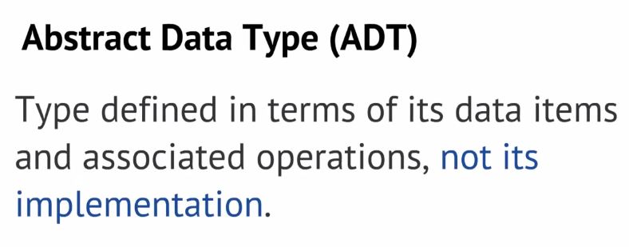

Slide 22
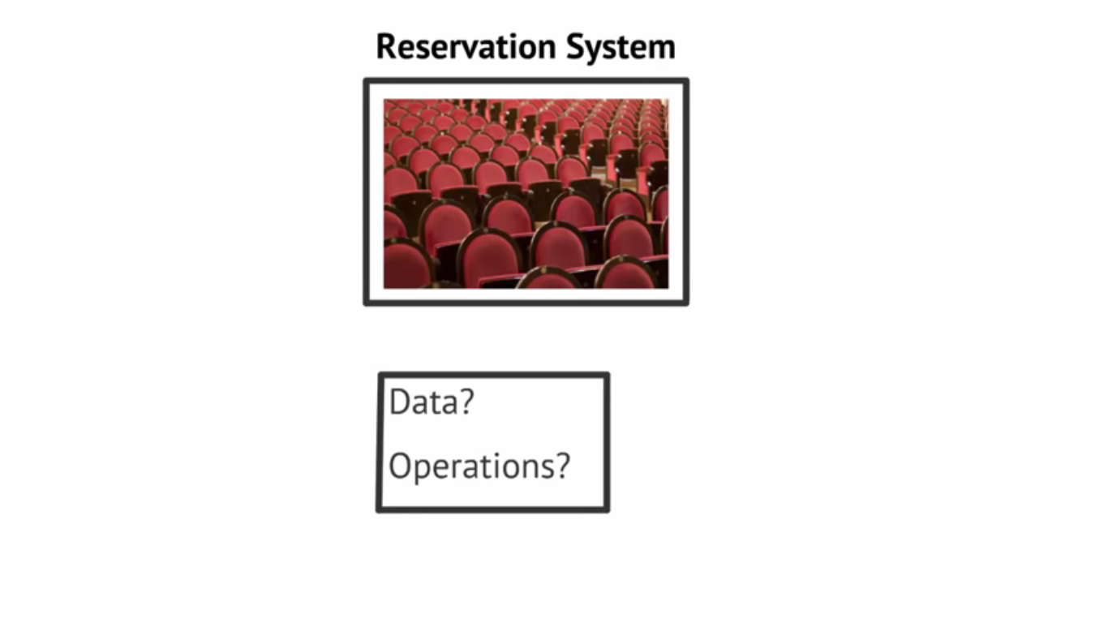

Slide 23
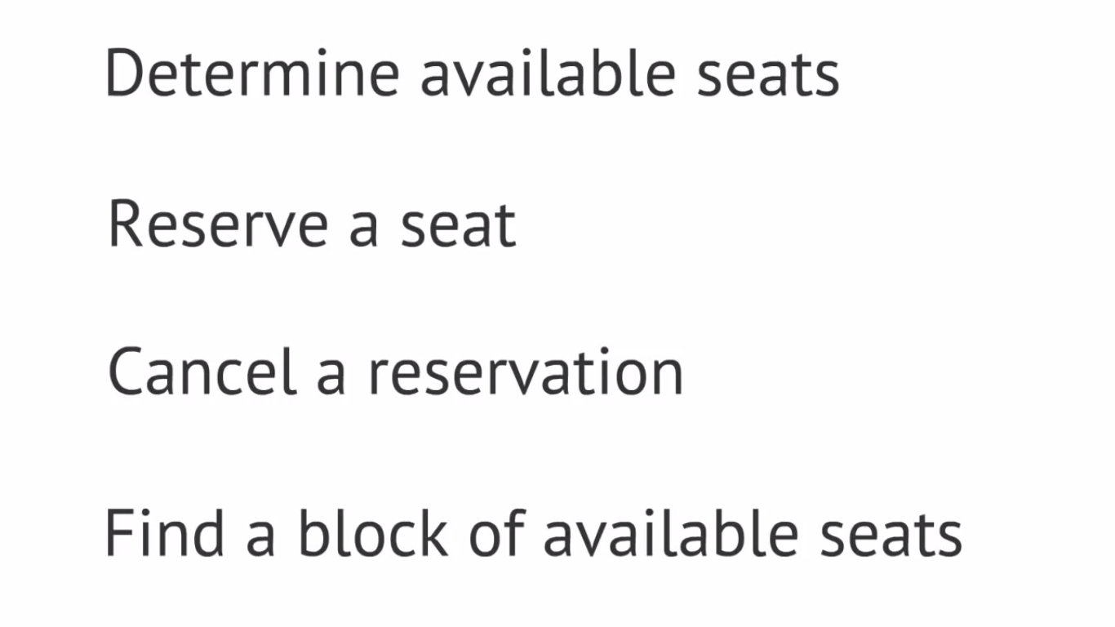

Slide 24
Abstract Data Types (ADT)
We are well acquainted with data types by now, like integers, arrays, and so on.
To access the data, we've used operations defined in the programming language for the data type, for instance by accessing array elements by using the square bracket notation.
An abstract data type is a data type whose representation is hidden from, and of no concern to the application code.

Slide 25
Abstract Data Types (ADT)
For example, when writing application code, we don’t care how strings are represented: we just declare variables of type string, and manipulate them by using string operations.
Once an abstract data type has been designed, the programmer responsible for implementing that type is concerned only with choosing a suitable data structure and coding up the methods.
On the other hand, application programmers are concerned only with using that type and calling its methods without worrying much about how the type is implemented.

Slide 26
ADT conclusion
An abstract data type is the specification of the data type which specifies the logical and mathematical model of the data type.
ADT acts as a useful guideline to implement a data type correctly.
The implementation of an ADT involves the translation of the ADT’s specification into syntax of a particular programming language.
For ex, the int data type, provides an implementation of the mathematical concept of an integer number.
The int data type in C can be considered as an implementation of Abstract Data Type, INTEGER-ADT, which defines the union of set { -1, -2, -3 …} and the set of whole numbers {0, 1, ....}

Slide 27
Array
Ordered Collection of Homogeneous elements
A single variable can be used to save a list of elements
Every array has index and it is crucial.
Almost all the programming language’s index for array start with Zero.

Slide 28
Showing array as an ADT
Let A be an array of type T and has n elements then it satisfied the following operations
CREATE(A,N): Create an array A with storage for N items of same type.
INSERT(A,X): Insert an element X into an array A in any location
DELETE(A,X): Delete an element X from an array A
MODIFY(A,X,Y): modify element X by Y of an array A
TRAVELS(A): Access all elements of an array A
MERGE(A,B): Merging elements of A and B into a third array C
Thus by using 1D array we can perform above operations thus an array acts as an ADT.

Slide 29
1 Dimensional Arrays
One dimensional array can be represented either as a single column or as single row.
Following are some valid array declarations:
  int age[15];
  float weight[40];
Following are some invalid array declarations in c:
  int value[0];
  int marks[0.5];
  int number[-5];

Slide 30
Some common operation performed in 1D array
Creating an array
Inserting new element at required position
Deletion of any array element
Modification of any element
Traversing of an array
Merging of arrays

Slide 31
Implementation of a two dimensional array
A two dimensional array can be implemented in a programming language in two ways:
  Row Major Implementation
  Column Major Implementation

Slide 32
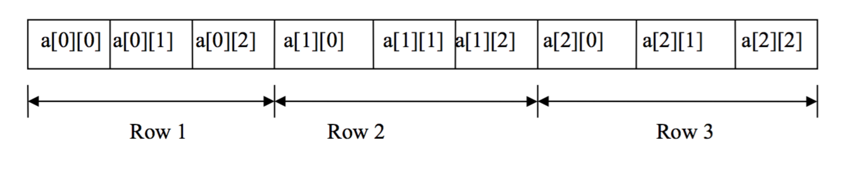
Row Major Implementation
Row-major implementation is a linearization technique in which elements of array are readers from the keyboard row-wise
The complete first row is stored and then the complete second row is stored.
For example, an array a[3][3] is stored in the memory as shown in fig below:

Slide 33
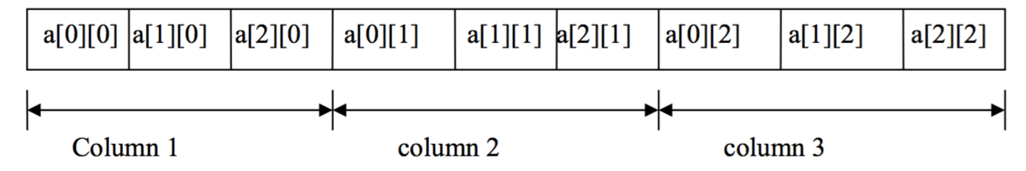
Column Major Implementation
In column major implementation memory allocation is done column by column i.e. at first the elements of the complete first column is stored, and then elements of complete second column is stored, and so on.
For example an array a [3] [3] is stored in the memory as shown in the fig below:

Slide 34
Multi-Dimensional array
C also allows arrays with more than two dimensions. For example, a three dimensional array may be declared by
int a[3][2][4]
Here, the first subscript specifies a plane number, the second subscript a row number and the third a column number.

Slide 35
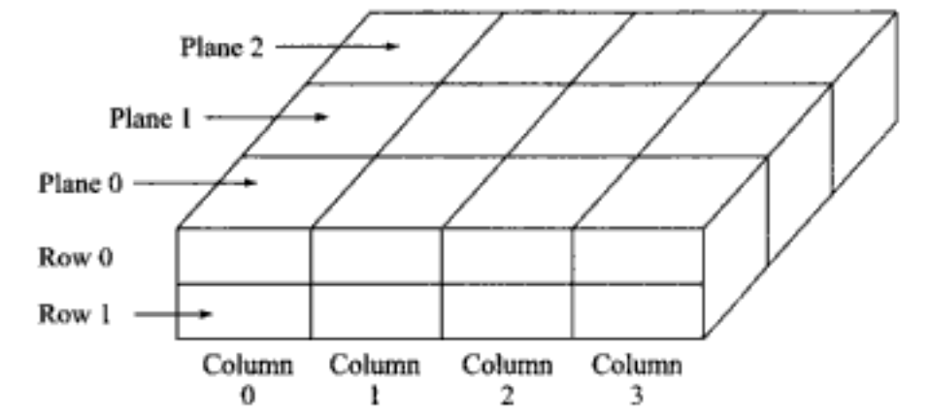
Multi-Dimensional array
Fig. Representation of array a[3][2][4]

Slide 36
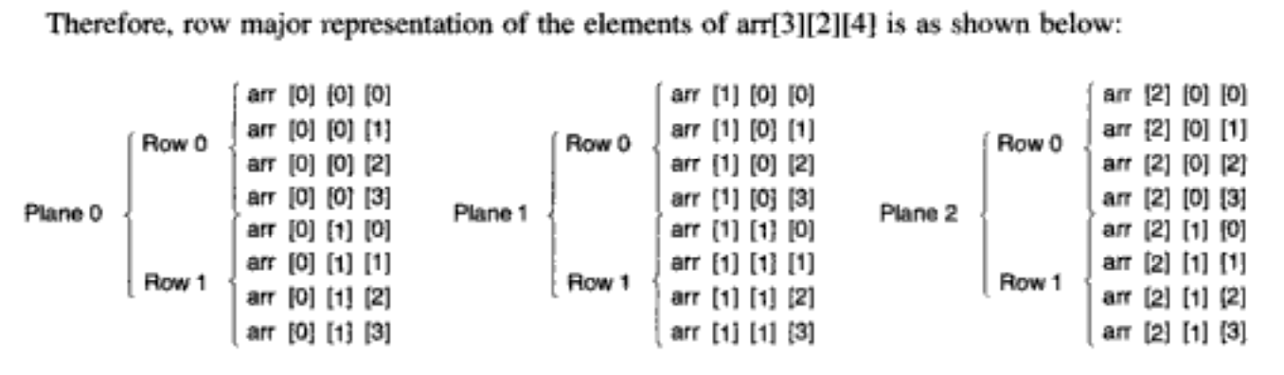
Multi-Dimensional array

Slide 37
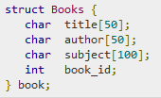
Structure
User defined data type available in C that allows to combine data items of different kinds.

Slide 38
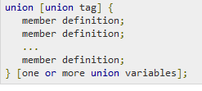

Union
A union is a special data that allows to store different data types in the same memory location.
You can define a union with many members, but only one member can contain a value at any given time.
Unions provide an efficient way of using the same memory location for multiple-purpose.

Slide 39
Structure Versus Union
The amount of memory required to store a structure variable is the sum of the size of all the members.
In case of structure, each member have their own memory space
In case of unions, the amount of memory required is always equal to that required by its largest member.
In union, one block is used by all the member of the union.

Slide 40
Conclusion
It is of utmost importance that the computer programs not only be correct but also be efficient; that is, consume less memory space and take less time to execute. Knowledge of data structure helps to fulfill that intention.
Data Structure refers to the collection of computer variables that are connected in specific manner.
Array is one of the most widely used data structure and is very important concept for the students of computer science.

Slide 41
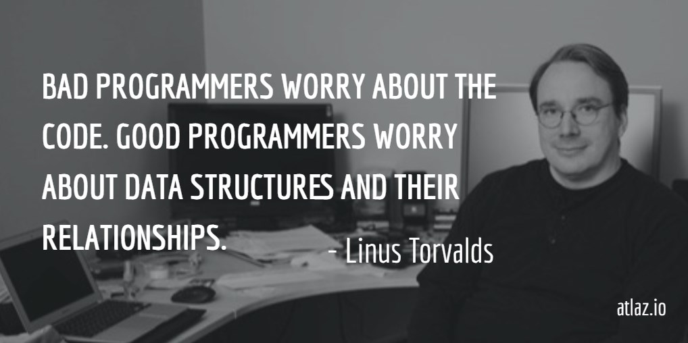

Slide 42
THANK YOU

